Slide 1
Housing Price Indicators
King County, WA

Slide 2
Exploration
View
Years since renovation
Price per Square Foot – Longitude
Zipcodes

Slide 3
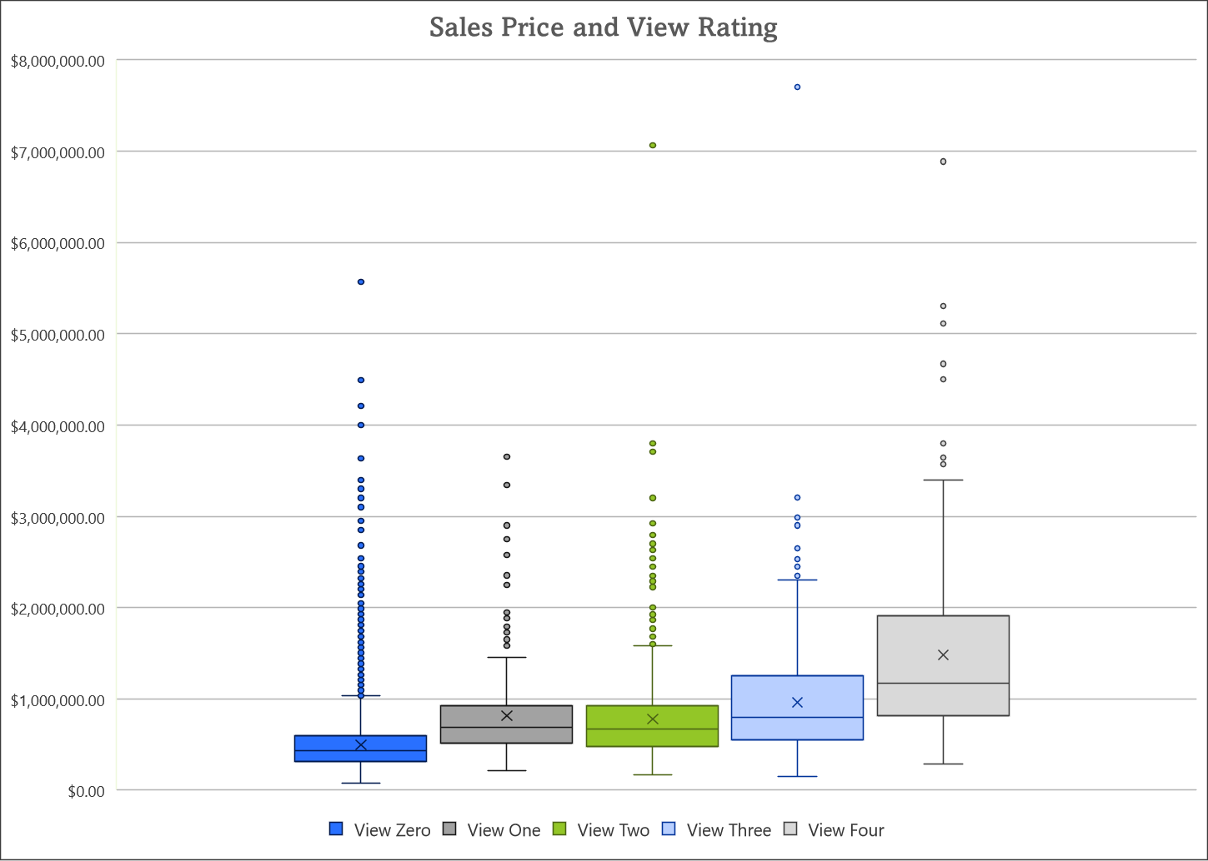
View
40% Correlation with Price
ANOVA Testing: P = 0

Slide 4
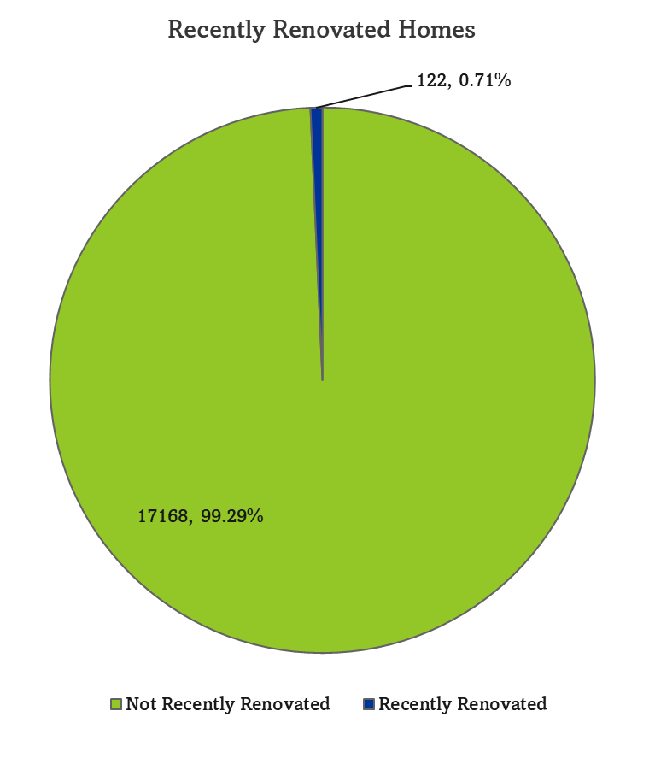
Recent Renovation
Years since built or renovated
‘Recent’ - 3 years or less
T-Test: P = 0.002
2% Correlation with Price

Slide 5
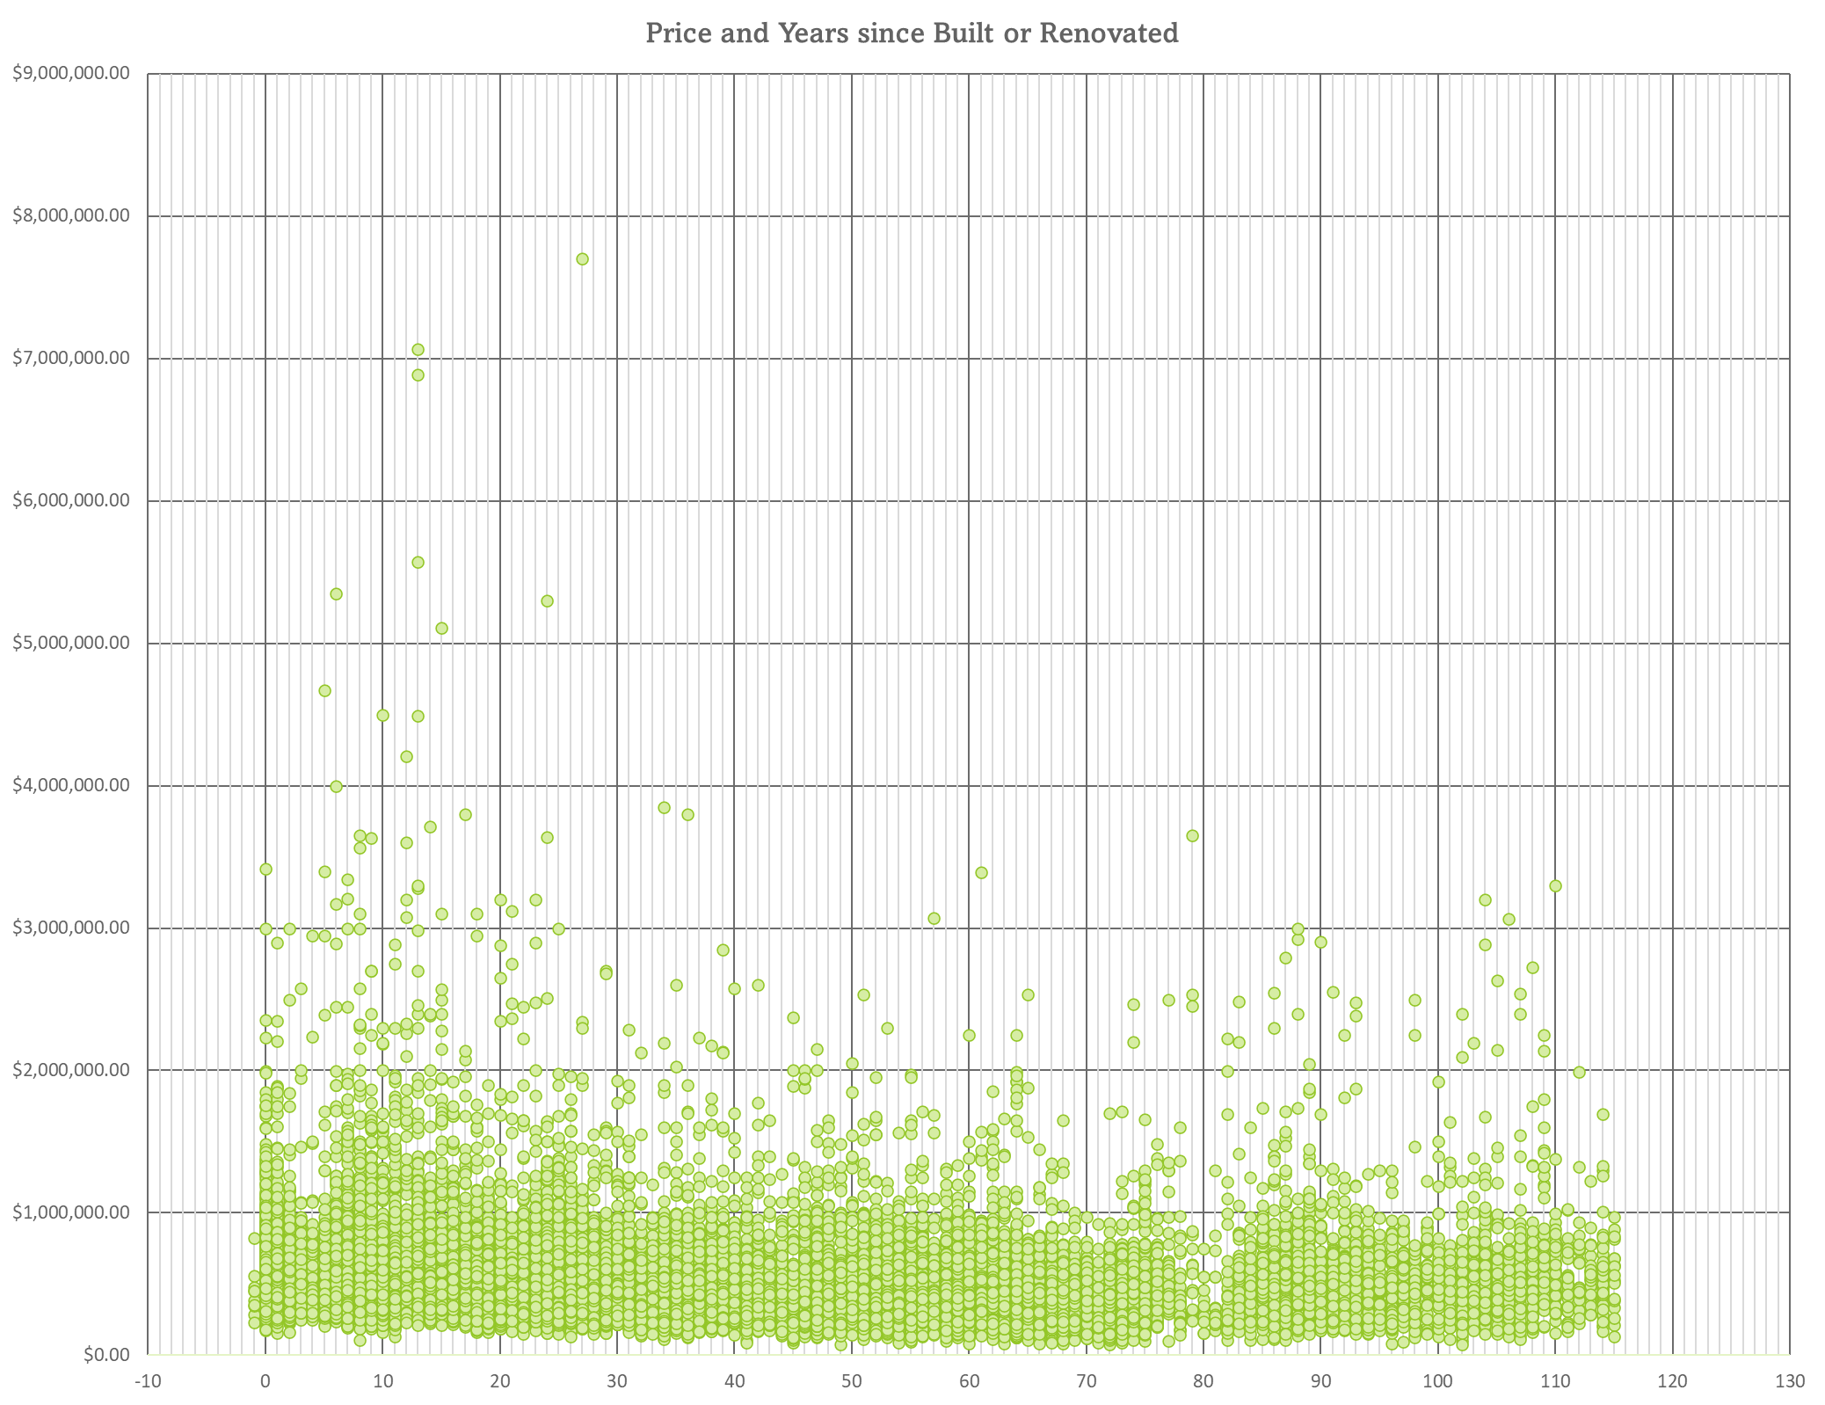
Recent Renovation
Years since built or renovated
‘Recent’ - 3 years or less
T-Test: P = 0.002
2% Correlation with Price

Slide 6
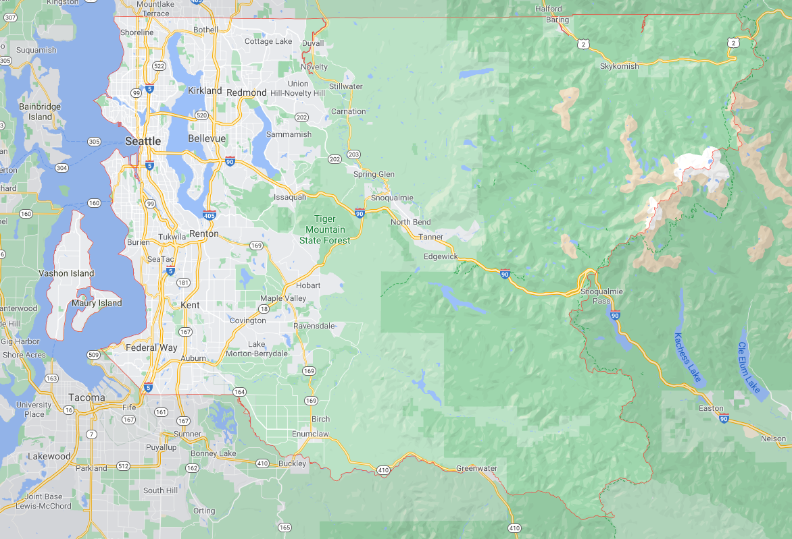
Price Per Square Foot and Longitude
OLS: R² for target price and feature: square footage times longitude = 0.496
OLS: P for target price and feature: square footage times longitude = 0

Slide 7
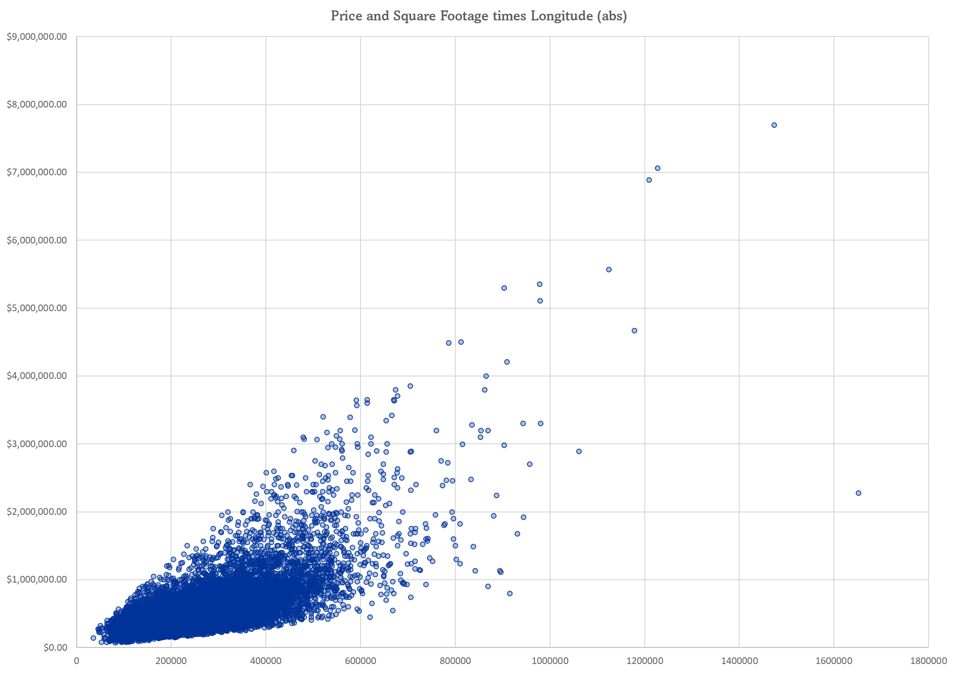
Price Per Square Foot and Longitude
OLS: R² for target price and feature: square footage times longitude = 0.496
OLS: P for target price and feature: square footage times longitude = 0

Slide 8
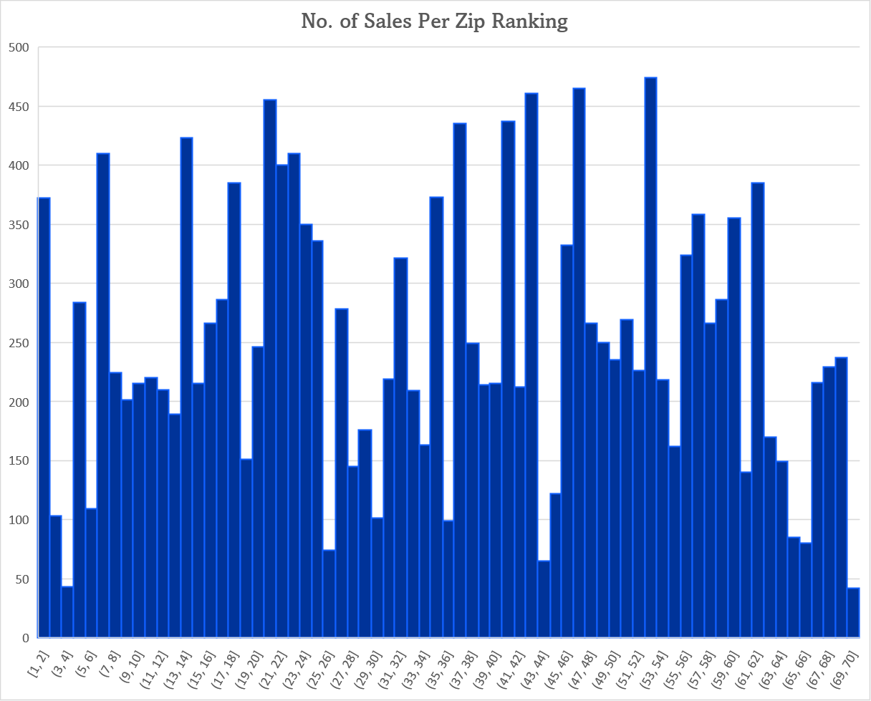
Zip Codes - Ranked by Mean Sales Price
Zip mean sales price
Rank and replace
OLS (for only this feature): R² = 0.332, P = 0

Slide 9
Summary
View
Price per Square Foot – Longitude
Zipcodes – proxy
Years since renovation

Slide 10
Thank You!

